Slide 1
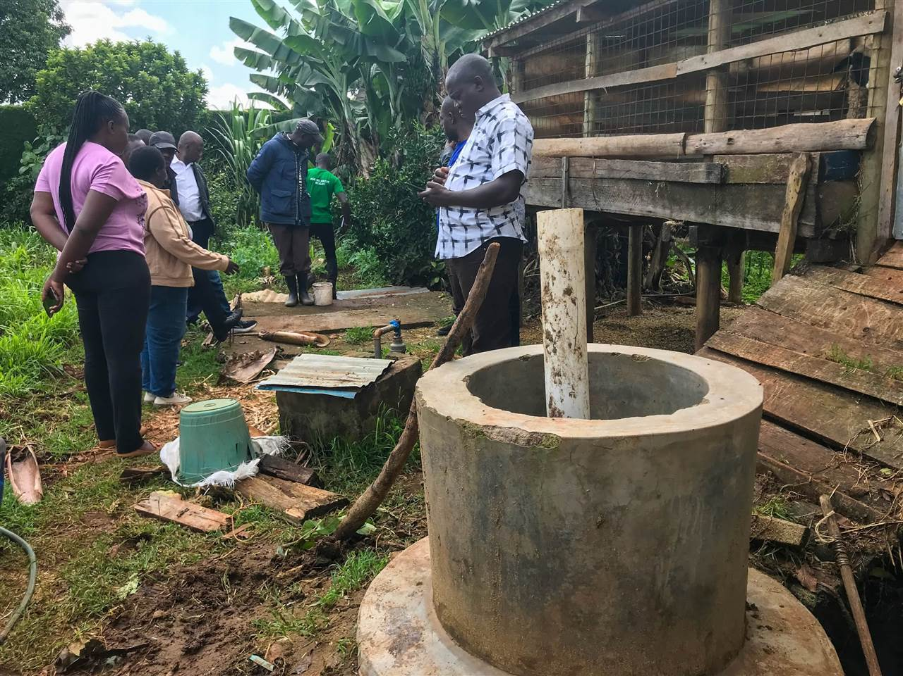

Access to Finance Kenya - Africa Biodigester Component (ABC)
PRESENTED BY:
PRIVATE EQUITY SUPPORT
October 2025
https://abc.privateequity-support.com/resources
1

Slide 2
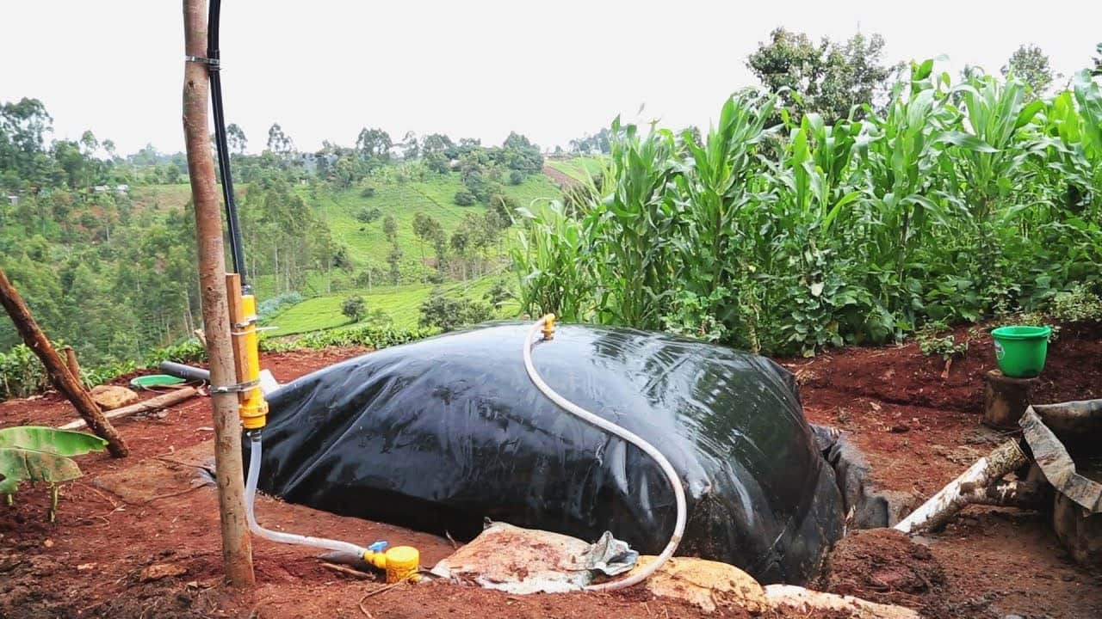
Table of Contents
INTRODUCTION
OVERVIEW OF THE PROGRAMME AND THE OBJECTIVE
TRAINING AND CAPACITY BUILDING MILESTONES
INCENTIVE SCHEME MILESTONES
THE PATH TO SCALE MILESTONES
THE SCALE UP PHASE
2

Slide 3
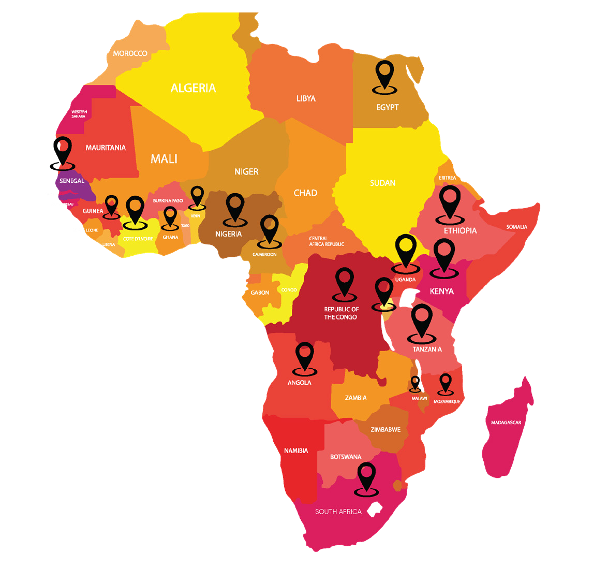

































25
PES IN BRIEF
Growing Businesses, Facilitating Investments
OVER
OVER
USD
28.5 Million
Capital Raised
400
SMEs
worked with
Countries
Kenya | Tanzania | Rwanda | Uganda | Benin | Mozambique | Gabon | Burkina Faso | Senegal | Guinea | Cameroon | South Africa | Angola | DRC | RDC | Ethiopia | Nigeria | Cape Verde | Togo | Malawi | Egypt | Ghana | Cote D’Ivoire | Zimbabwe | Botswana
43%
Entrepreneurs under 35 years
48%
Women Entrepreneurs
Sectors
Climate Smart | E-mobility | Education | Edutech | Health Tech Agro Processing | Agro Tech | FMCG | Manufacturing | W ASH Financial Services | Hospitality | Real Estate | Clean Technology
Institutions Worked with
KENYA INVESTMENTS MECHANISM

Slide 4








ABC PROGRAMME ORGANISATIONS
Co-financed by
Co-ordinated by
In partnership with
Implemented by
Access to finance - Kenya
4

Slide 5

OBJECTIVE OF THE ABC PROGRAMME
“To achieve a sustainable, stable and growing market for biodigesters that significantly contributes to achieving national energy access and climate targets, by following a market-based approach to triggering demand, promoting the supply of high-quality technology and services and improving the enabling environment.”
5

Slide 6
BROADER GOALS
Target by 2025
20,017 small-sized biodigesters and 250 medium-sized biodigesters
750,000
Small scale biodigesters
105,000
Medium scale biodigesters
Potential market for biodigesters in Kenya
Design and implement actions contributing to increasing access to finance for (M)SME’s active in any part of the supply chain
Map core activities that will increase access to finance into the biodigester market
(Co-)develop loan products specifically designed for end-users
6

Slide 7
WHY ‘ACCESS TO FINANCE’ FOR BIODIGESTERS
Objectives of implementing the incentivization model
Create awareness and create interest about the biodigester programme
Standardised approach to basic ‘access to finance’ evaluation of biodigester lending
Enhancing the technical understanding of the FI teams
FI officers understand where the opportunities are and type
Stimulate loans/lending for the biodigester sector (HH, Aggregators)
7
Notes:
7

Slide 8
SCOPE, AIM AND AMBITION- ACCESS TO FINANCE
Engage with (Micro) financial institutions operating in Kenya with an interest in the biodigester sector
Make an inventory of existing green’ credit lines and loan products available for the end-users and (MS)MEs active in the small scale biodigester sector
(Co-)Develop or adapt credit lines and loan products for end-users and (M)SMEs active in the biodigester sector together with financial institutions, SACCOs, cooperatives etc.
Implement training and design of training materials on developed credit lines and products, in close collaboration with ABC-Kenya’s lead implementers.
(Co-)Design an incentive mechanism(s) for (Micro)Finance Institutions.
Provide advice and guidance on how to increase financial activities into the biogas market. Especially empowering ABC-Kenya’s lead implementers to scale best-case practices.
Support RVO and ABC-Kenya’s lead implementers with the design and roll-out access to finance concepts, including (but not limited to) a concessional subsidies design for (m)FI’s/ programs (for provision of lower-interest loans), bio-slurry tick off pilot and opportunities for biodigester enterprises to become eligible for national loan guarantees facilities and collateral schemes.
 | Completed
 | In progress
 | Not started
8
Notes:
8

Slide 9
WHAT BARRIERS ARE WE TACKLING
Issues faced by FIs in lending to the sector
Lack of awareness on sector
Access to suitable costed funding
Scalability and the business case for biodigesters
Sustainability of this post scheme
Technical know how to evaluate of bio digesters projects
Sub –sector and CVP under existing products
Risk mitigation for this lending (guarantees, first loss mechanisms)
9
Notes:
9

Slide 10
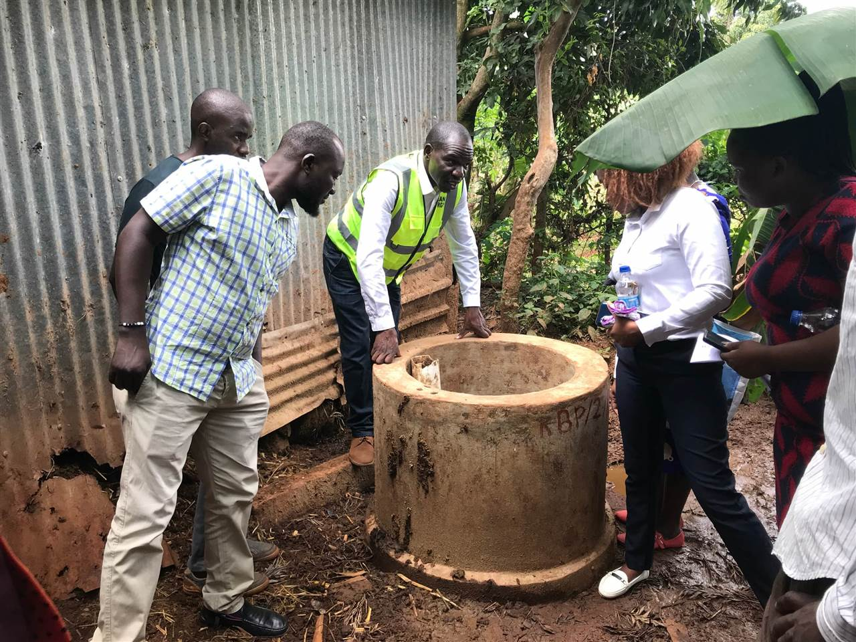
MILESTONES ACHIEVED THUS FAR
August 2024 to July 2025 (12months)
10
Notes:
10

Slide 11
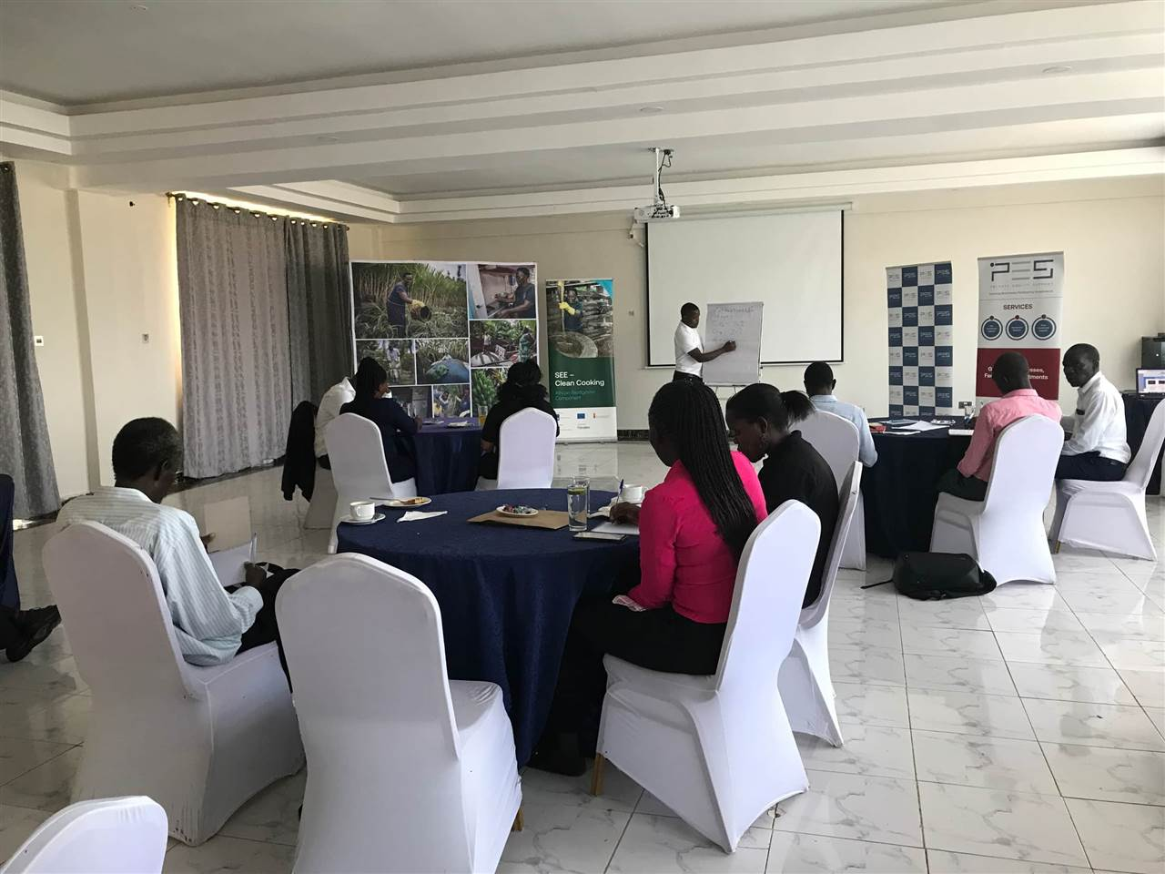
MILESTONES ACHIEVED THUS FAR
TRAINING AND CAPACITY BUILDING
11
Notes:
11

Slide 12
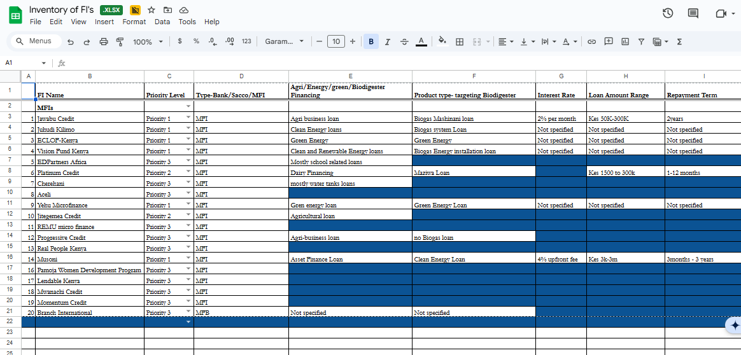
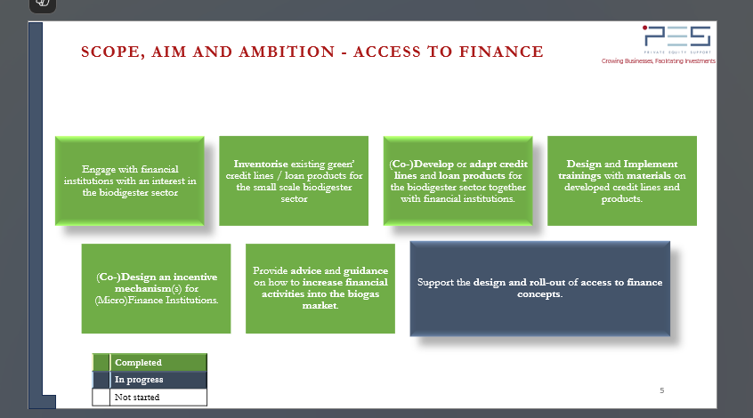
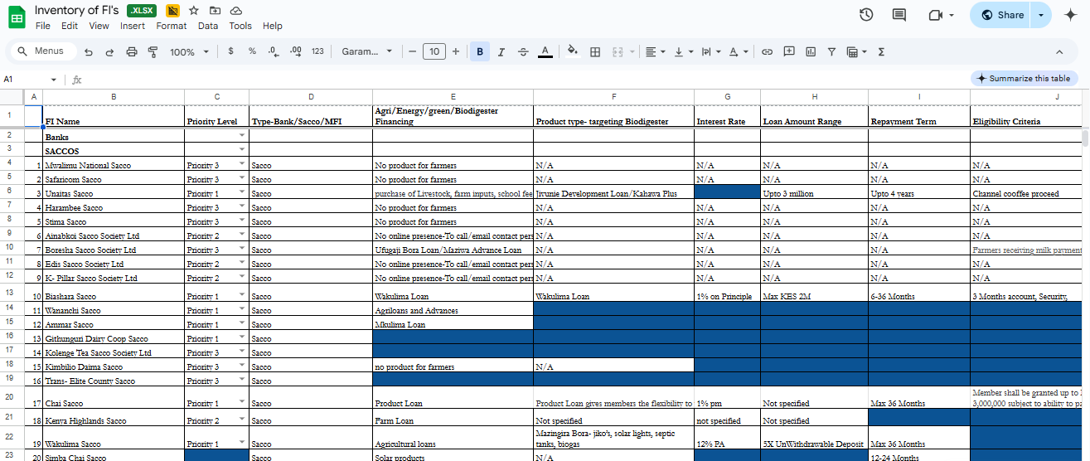
INVENTORISE EXISTING GREEN’ CREDIT LINES LOAN PRODUCTS FOR THE SMALL SCALE BIODIGESTER SECTOR
12
Notes:
12

Slide 13

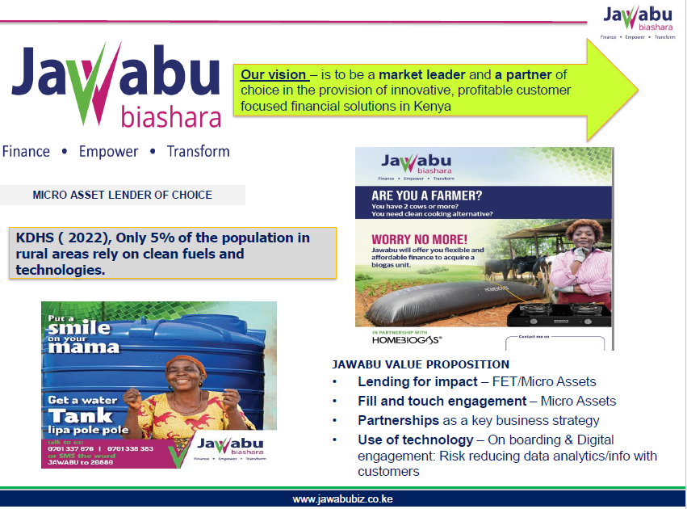
(CO-)DEVELOP OR ADAPT CREDIT LINES AND LOAN PRODUCTS FOR THE BIODIGESTER SECTOR TOGETHER WITH FINANCIAL INSTITUTIONS.
13
Notes:
13

Slide 14
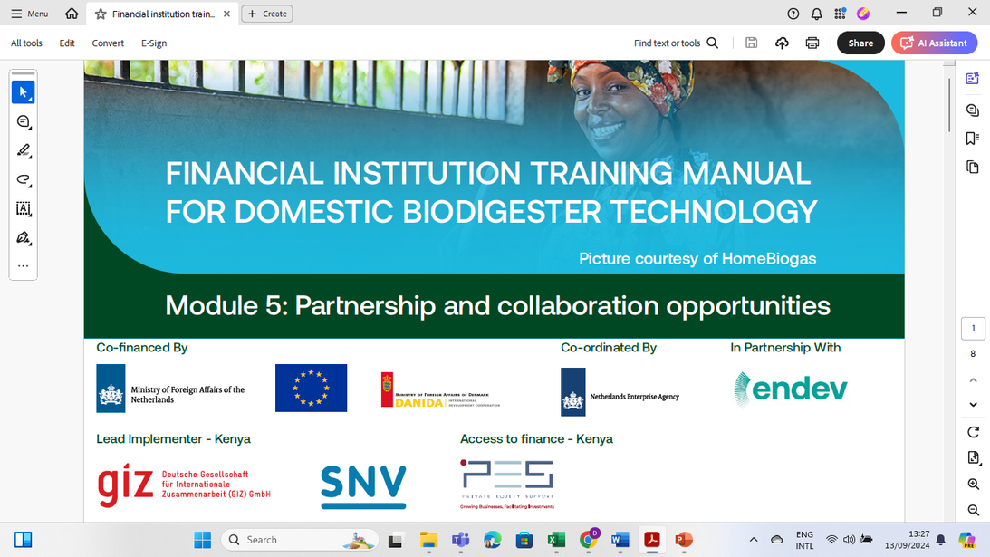
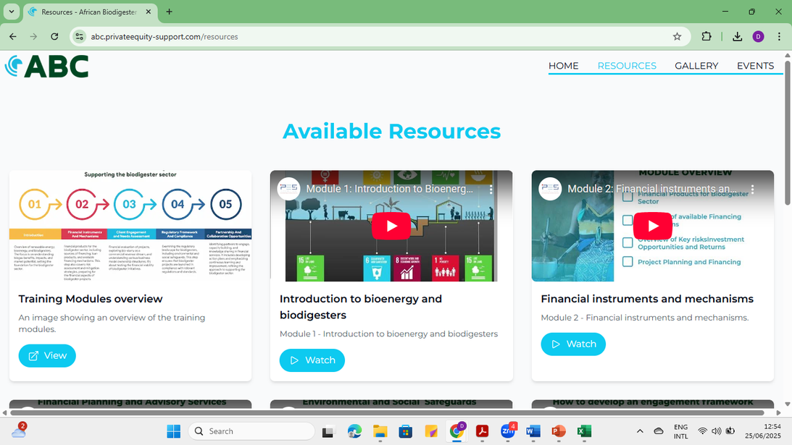
DESIGN AND IMPLEMENT TRAININGS WITH MATERIALS ON DEVELOPED CREDIT LINES AND PRODUCTS.
Trainer modules developed for FIs and rolled out
https://abc.privateequity-support.com/resources
Digitalization of learning resources on website
14
Notes:
14

Slide 15
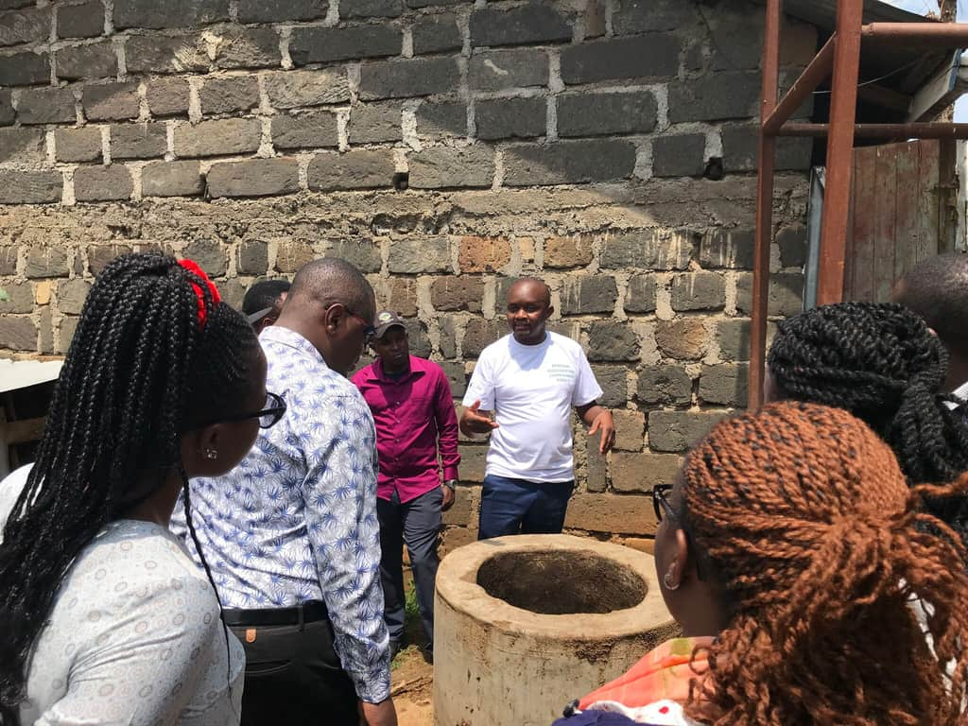
TRAINING MILESTONES
Overview of the training workshops
Private Equity Support in collaboration with the GIZ, as part of the capacity building initiative has been organizing for training workshops across various counties in Kenya to train financial institutions in biodigester technology and build their capacity to support the biogas market adoption though providing the necessary financial services.
These trainings targets representatives from immediate and surrounding regions and is practical (includes site visits to biodigester sites) and includes masterclass sessions (group work, presentations and co-creation classroom sessions) The training is carried out in two groups per week, with each group being engaged for two days within a specific county.
The following training sessions have been held across the country
Nyeri 9th to 12th July 2024
Muranga - 15th to 18th July 2024
Nakuru 6th to 9th August 2024
Eldoret 12th to 15th August 2024
Bomet 27th to 30th August 2024
Kisumu 2nd to 5th September 2024
Kisii 9th to 12th September 2024
Kajiado 23rd to 27th September 2024
Training of financial institution participants on practical aspects
15
Notes:
15

Slide 16
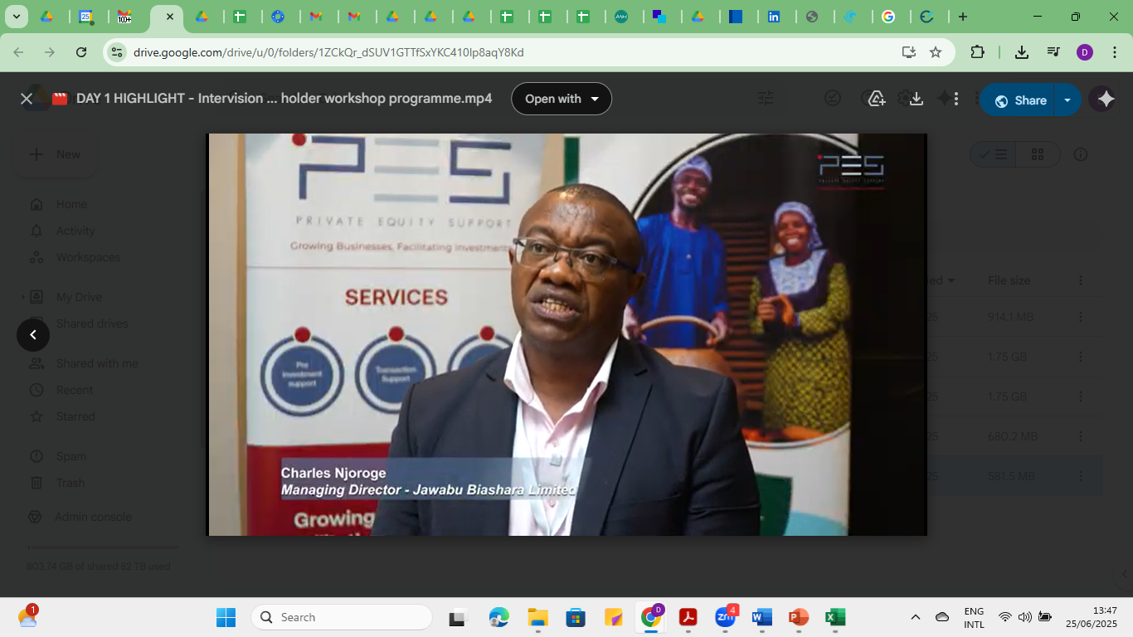
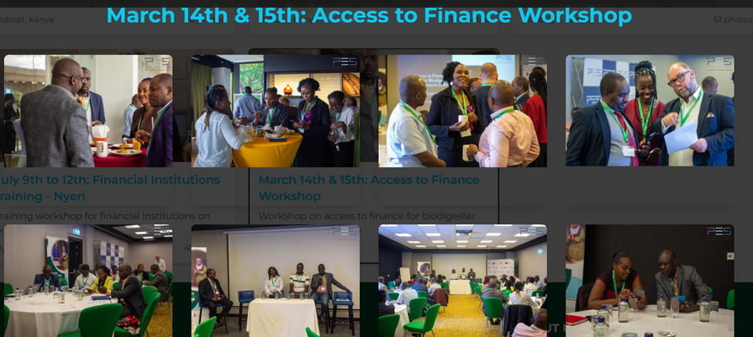
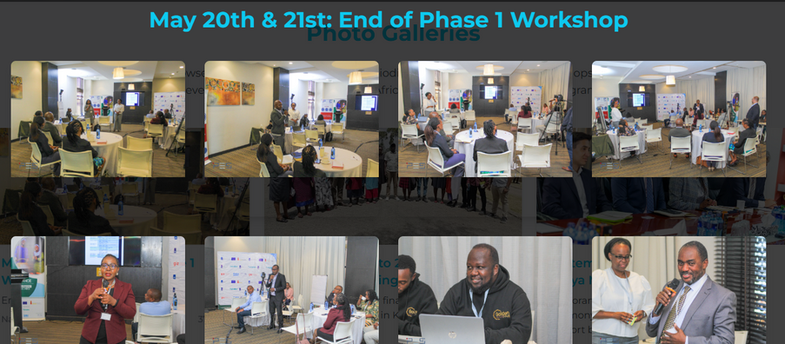


PROVIDE ADVICE AND GUIDANCE ON HOW TO INCREASE FINANCIAL ACTIVITIES INTO THE BIOGAS MARKET
Intervision workshop day 1
Intervision workshop Day 2
THE PES INTERVISION WORKSHOPS
2024, 2025
Wholesale lending to Ammar Sacco
16
Notes:
16

Slide 17
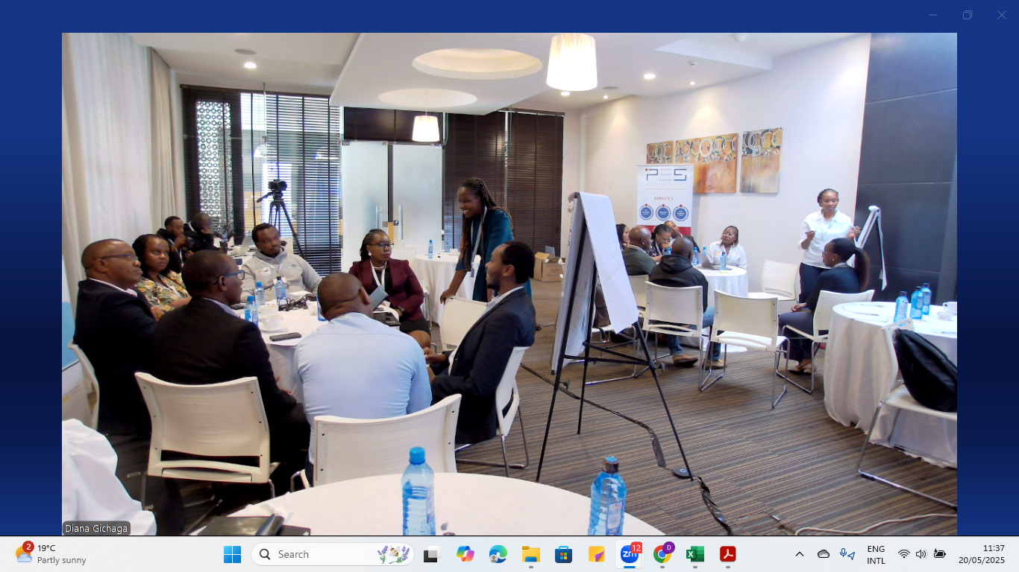
17

Slide 18
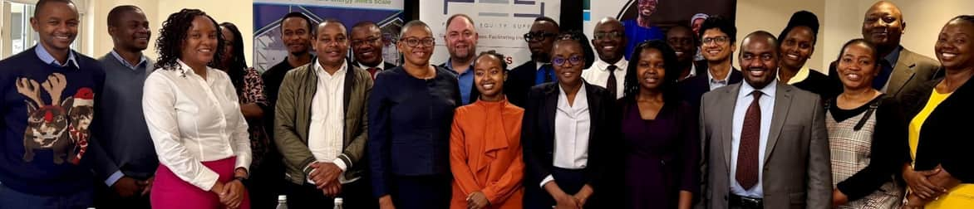
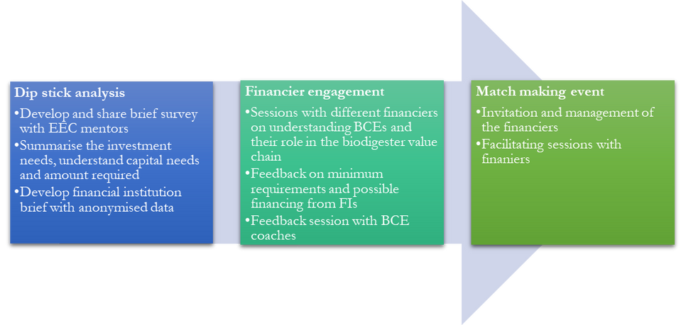

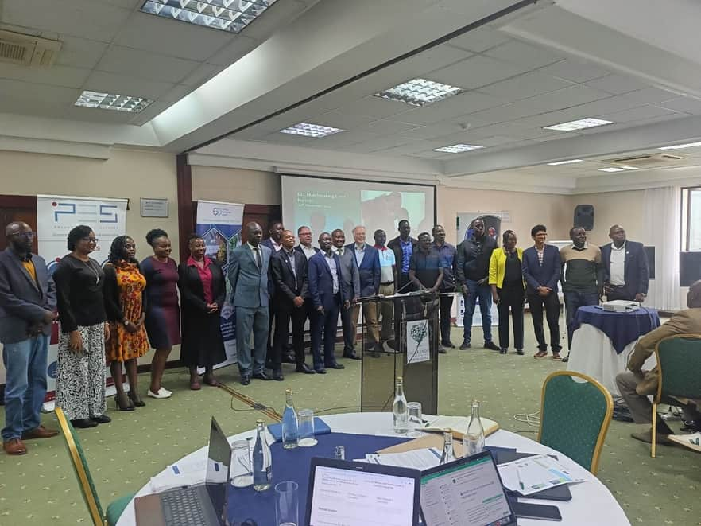
SUPPORT THE DESIGN AND ROLL-OUT OF ACCESS TO FINANCE CONCEPTS
African Biodigester Component (ABC) Uganda project
SEE-Clean Cooking Cross-Country Webinar Series:
“The Progress, challenges and Opportunities in the implementation of SEE-Clean Cooking Thematic Topics.
THE PES NIRAS EEC FINANCIERS’ ROUND TABLE AND MATCHMAKING EVENT
18
Notes:
18

Slide 19
LESSONS LEARNT FROM TRAINING FIs AND BCEs
Overview of the general observations
2-day trainings per county optimal
Having FIs and BCEs present at sessions leads to collaboration
Practical training approach [Site visits and simplified material] is optimal
Feedback from learnings should be tested and/or implemented in a timely manner
Follow on sessions to keep momentum within institutions
Better collaboration with market awareness teams closes the loop
Responsibility (implementation) and accountability (budget ownership) for trainings should be within 1 party
19
Notes:
19

Slide 20
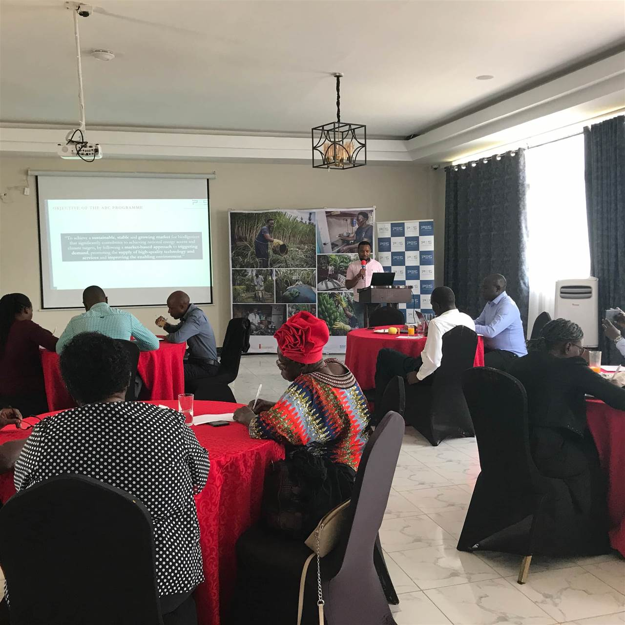
MILESTONES ACHIEVED THUS FAR
INCENTIVE SCHEME
20
Notes:
20

Slide 21
INCENTIVE SCHEME ENGAGEMENT OVERVIEW
Forward-looking, co-creational and iterative approach
1. Identify interest
6. Pilot and lessons learnt
7. Validate findings
2. Review existing products
5. Co develop approach, solution
8. Scale informed by findings
WE ARE HERE
ENGAGE WITH NEW PARTNERS TO VALIDATE AND SCALE SUCCESS
3. Review reach and scope (people, place)
4. Identify low hanging fruit
21
Notes:
22

Slide 22
INCENTIVE SCHEME SCOPE OVERVIEW
‘Access to Finance’ Incentive Scheme structure
Co-creation
Capacity building –
De-risking A2F
Co-development
Technical linkages –
Financial Incentive scheme – RVO
23
Notes:
23

Slide 23
INCENTIVE SCHEME FINANCIAL INSTITUTIONS
The financial institutions that participated in the pilot
16 Initial FIs
HALFWAY THROUGH PILOT
AT PILOT START IN AUGUST 2024
2 Banks
2 SACCOs
2 Banks
2 SACCOs
11 Pilots
4 MFBs
3 credit only institutions
0 MFBs
1 credit only institutions
23
Notes:
24

Slide 24
(CO)DESIGN AN INCENTIVE MECHANISM(S) FOR (MICRO)FINANCE INSTITUTIONS
12 months (August 2024 – July 2025)
3X
leverage
Spotlight incentives (SI): An FI receives a monetary incentive linked to target short-term performance
1058 loans* uploaded in the system
485 biodigesters verified
KES. 50.4M in loans issued [Eur 336K]
5 Financial institutions participating, 8 counties represented
EUR 105
995 loans approved for first verification [Loan issuance verified]
EUR 86,147 in incentives provided and EUR 95,272 for pending disbursement
100% of target loans achieved in 12 months
Training: In conjunction with GIZ and other partners, PES provides in county capacity building for all FI staff.
24
Notes:
25

Slide 25
INCENTIVE SCHEME PROGRESS OVERVIEW
12 months (August 2024 – July 2025)
CHALLENGES IN IMPLEMENTATION USING THE SOFY SYSTEM
Batch uploading errors [ easily correctable. All information present but not in correct collumn]
SOFY system teething issues
Delays in contracting process [ MOUs with FIs live and being actioned prior to official start date]
Lack of access to the GIZ RBF Biodigester data
FI onboarding onto system lengthy owing to limited training of FIs on SOFY
Team and ownership changes in at least 2 FIs
25
Notes:
26

Slide 26
INCENTIVE SCHEME –LESSONS LEARNT
12 months (August 2024 – July 2025)
FIs move at different pace depending on type of regulation
Each FI will design a scheme best suited for their wants and needs [market based and led approach]
Under estimation of support required to FIs to foster success
Willingness of FIs to scale hampered by lack of agreed budget
FIs move at different pace driven largely by management willingness to commit resources
More knowledge dissemination required within each institution to allow for better implementation results
Under estimation of time it takes incentive manager to originate, review, approve and verify uploaded loans
26
Notes:
27

Slide 27
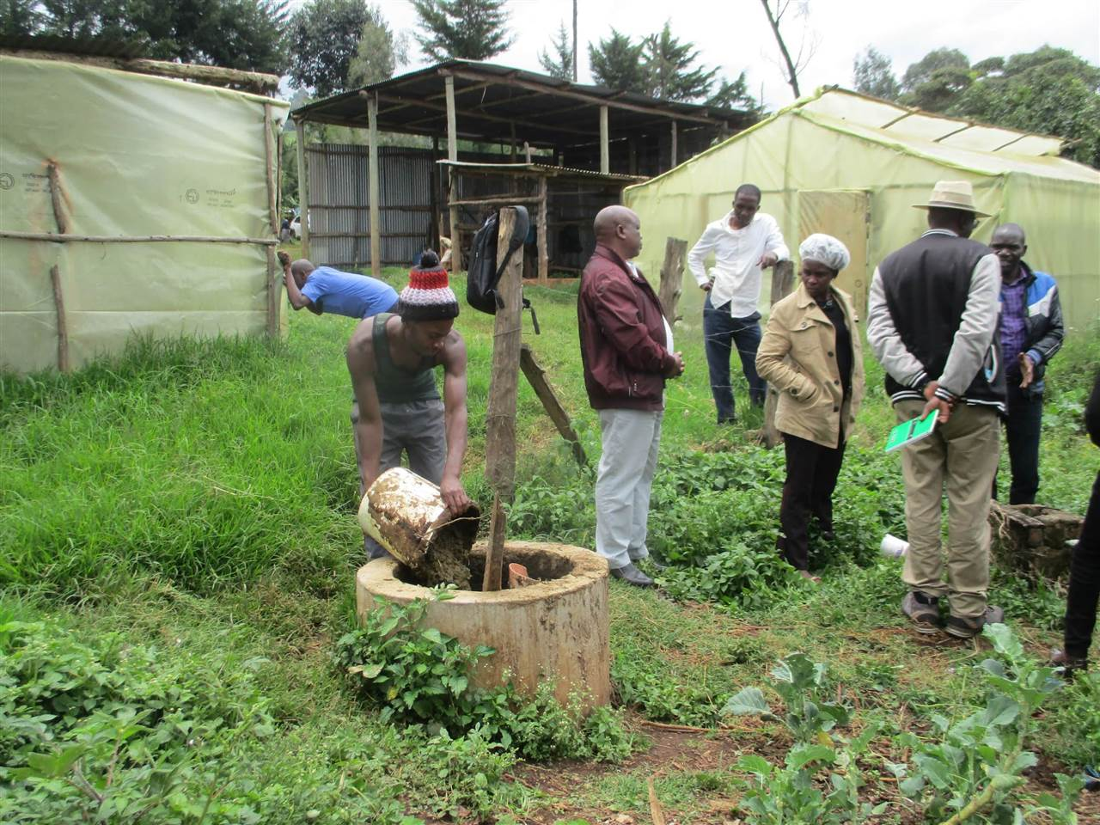
MILESTONES TO BE ACHIEVED
THE PATH TO SCALE
28
Notes:
28

Slide 28
PATH TO SCALE
Next Phase
Long term access to leveraged blended finance
Public good resources
Scale learnings to other vital sectors
Recognition of individual FI needs and abilities
Publication and dissemination of best practice models from pilots
Partnerships to scale
FIs further capacity building
28
Notes:
29

Slide 29
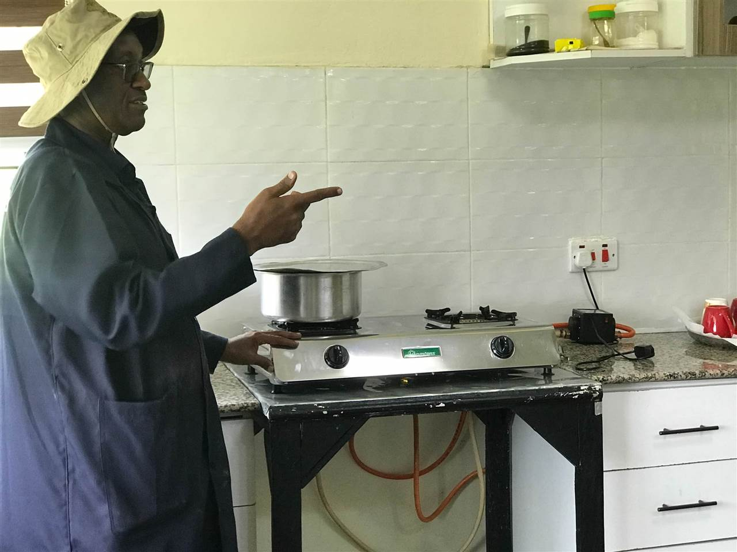
SCALE UP PHASE
29
Notes:
30

Slide 30
OVERVIEW OF THE SCALE UP PHASE
Virtual and In person trainings –October-December 2025
Target numbers-
Small scale biodigester-870 units
Medium scale biodigesters-10 units
Start October 2025-March 2026
Letter of intent and MOU signed with FIs by October 2025
30
Notes:
31

Slide 31
NEXT STEPS FOR SCALE UP PHASE
Key steps in participating during scale up phase for the Financial Institutions
1
2
3
4
5
6
Participate in the onboarding webinar on 23rd October 2025 to understand the target group, key financial players, the business case for biodigesters and the overall design of the assignment.
Signing the letter of intent and memorandum of understanding by end of October 2025
Development of the biodigester loan targets per financial institution together with PES dedicated relationship manager
Sign up for participating in the virtual and in person trainings
Uploading the loan items into the Sofy system and the supporting documentation
Applying for the incentive scheme
31
Notes:
33

Slide 32
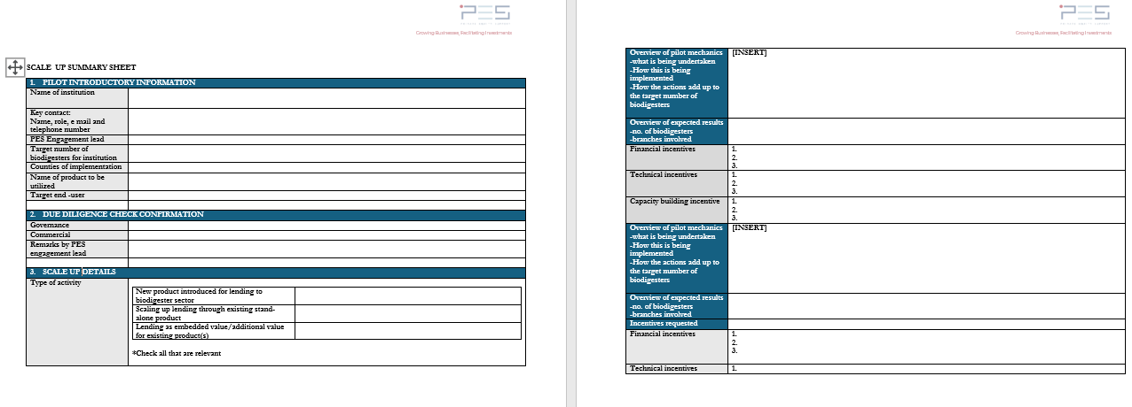
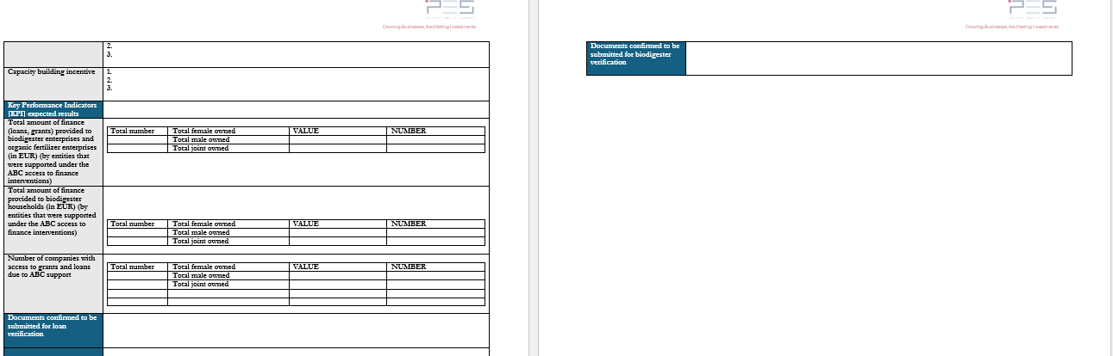
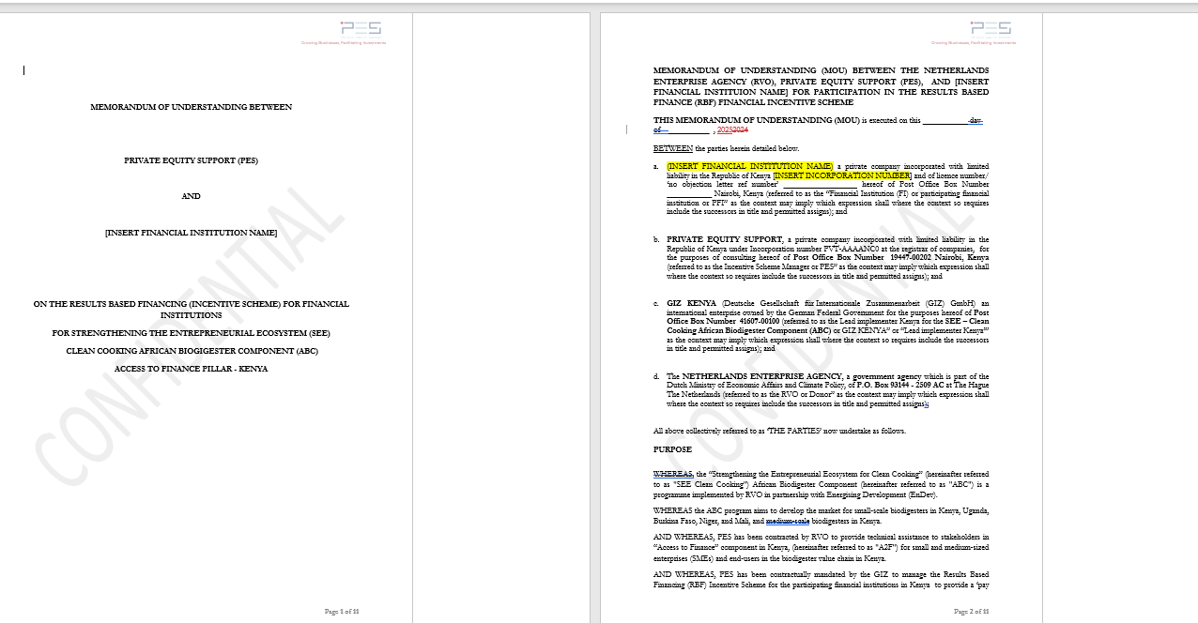
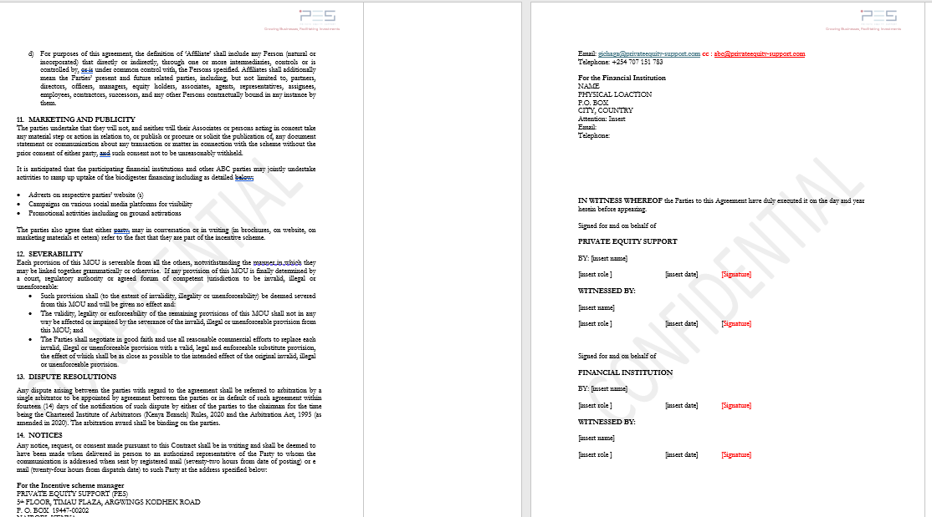
SNAPSHOTS OF SCALE UP DOCUMENTS
Some of the key data to be captured in the FI Scale up summary sheet and MOU documents is as shown below
32
Notes:
33

Slide 33
PHASE 1 VERIFICATION REQUIREMENTS
For verification purposes the MFI should provide the below requirements while uploading into the Sofy system and thereafter provide an incentive request by the 20ᵗʰ of each month (with exception of December, which will occur on the 10ᵗʰ) but not limited to;
Data requirement | To be verified
Loan ID | Is the loan ID unique?
Loan issuing date | Is the loan provided after the project start date (i.e. contract date)?
Loan amount | Is the loan amount received by the borrower?
Account number | Is the loan linked to a borrower?
First name of borrower
Last name of borrower
Payment schedule | Does the loan agreement specify the payment schedule?
Beneficiary contact details | Is the mobile number in the system similar to the one in the loan application form?
Prove of acceptance | Is the loan agreement signed by lender and borrower?
Purpose of loan | Does the loan specify the purpose of the installation of a biodigester?
Approved loan application form
Executed loan offer letters
Approved loan appraisal forms
Bankers’ cheque copies
Bank statement showing disbursements
System generated reports
33
Notes:
32

Slide 34
PHASE 2 VERIFICATION REQUIREMENTS
Minimum data requirements for phase 2 verification are as follows;
Data requirement | To be verified
Biodigester ID | Is the biodigester ID unique?
Biodigester model | Is the biodigester model eligible?
Biodigester size (m3)
Installation date | Is the biodigester installed after the loan agreement date?
Beneficiary first name | Is the beneficiary (or another member of the household) the borrower of the loan?
Beneficiary last name
Beneficiary sex
Address of beneficiary (description of location, e.g. neighbourhood, town, village, and sub county) | Is the location of the biodigester installation provided?
GPS coordinates
Phone number of beneficiary | Is the phone number of the beneficiary (or representative) provided?
Additional requirements for fixed dome digesters
Bill of Quantities
Contract
Commissioning certificate
34
Notes:
33

Slide 35
ADDITIONAL SUPPORT TO FIs BASED ON THE PILOT PHASE LEARNINGS
One on one financial institution trainings
Africa Bioenergy Programs Limited [ABPL ]Training sessions
Additional marketing support to the financial institutions
Updated ABC Website
35
Notes:
27

Slide 36
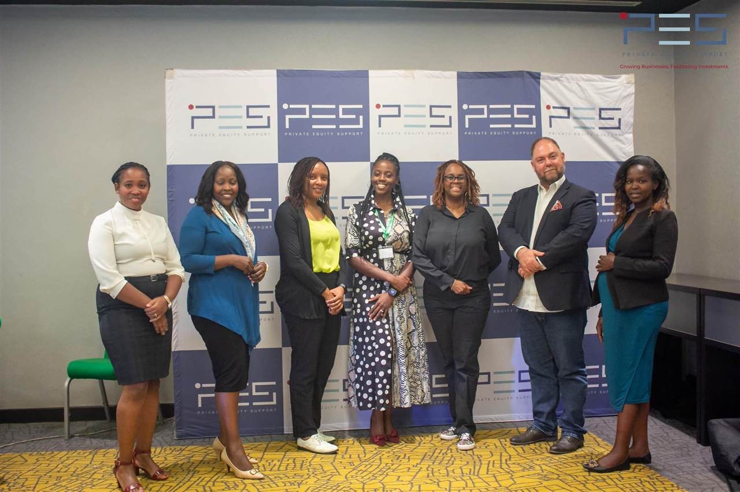
CONTACT:
Private Equity Support
Office Mobile: +254 0707 151 783
5ᵗʰ Floor Timau Plaza
36
E mail: abc@privateequity-support.com Website: www.privateequity-support.com

